Slide 1
To Find Relative Earnings Gains after the China Shock, Look Outside Manufacturing and Upstream
Justin R. Pierce Board of Governors, U.S. Federal Reserve
Peter K. Schott Yale School of Management & NBER & CEPR
Cristina Tello-Trillo U.S. Census Bureau July 2025

Slide 2
Disclaimer
The views expressed in the paper are those of the authors and not necessarily those of the U.S. Census Bureau. The Census Bureau's Disclosure Review Board and Disclosure Avoidance Officers have reviewed this data product for unauthorized disclosure of confidential information and have approved the disclosure avoidance practices applied to this release. DRB Approval Numbers CBDRB-FY21-CES006-002, CBDRB-FY21-327, CBDRB-FY22-CES020-001 and CBDRB FY25-CES020-0.

Slide 3
Motivation
Many papers examine the impact of labor-market shocks on earnings
Lots of attention on the “China shock”
Focused on manufacturing
Generally use regions or industries as a unit of analysis
Mostly consider “own” region or industry exposure
Here,
Focus on workers
Look outside manufacturing
Compare impact of industry and spatial exposure
Incorporate up- and downstream exposure
Compare results for high- vs low-tenure workers
Examine variation in outcome by demographic attributes
Notes:
11-12:15pm
Hakobyan and Mclaren look at NAFTA: they find the lowest educated are hurt
Autor et al look at Chinese import penetration over a long difference, 1992-07; they look only at the direct effect on workers long-term earnings an employment
Dix Carneiro and Kovak (2017) e “regional tariff reduction” look at workers exposure to tariff declines based on their regions’ exposure to these declines.
following the Brazilian trade liberalization of the early 1990s. Using 25 years of data they find large and growing effects of trade liberalization on regional formal
earnings and employment, main reason lack of labor mobility.
Devlin kovak morrow: This paper uses matched longitudinal administrative data for Canadian workers during 1984-2004 to assess the long-run effects of the 1988 Canada-U.S. Free Trade Agreement (CUSFTA) onthe Canadian labor market. No cumulative long-terms effects, increase export expansion accompanied by import competition, in the short term they do see increase in separations (out of the labor force) long term no big effects, earnings fo back to normal.
For workers initially in man-ufacturing industries that experienced Canadian concessions, we find a heightened probability ofwork-shortage based separations at large firms but little impact on long-run cumuilative earnings.Lower cumulative earnings at the initial employer are offset by gains outside manufacturing. ForCanadian workers in industries that obtained U.S. concessions, we find a lower probability of sep-aration and higher cumulative earnings. These effects are concentrated among workers initiallyemployed in larger firms, and there are important differences between low and high attachmentworkers.
All of these papers are a bit different: We look at a specific trade liberalization like T, HM, DCK but look at China’s impact on US like Autor. Unlike Autor but like HM we look at the impact at different levels or education. Unlike Autor, we look specific trade liberalization.
so, why does this matter?
Isn’t what we find obvious?
Are we trying to recover frictions?
This paper extends the literature on labor market impacts of trade by shifting the focus from aggregate market level reactions to adjustments at the worker level. We will be able to quantify the distribution of incidence among workers along two margins, industry and county margin. ADHS (2014) are able to measure worker-level consequences by focusing on the substantial differences in trade exposure that derive from the initial industry of employment (but not location). We are able to decompose the magnitude of both, the initial industry of employment and also the location of employment. Our 5% extract of the LEHD (for large counties) and 100% extract for small counties provides a more precise measurement of local industry composition.
AHD (2013) is aout changes in employments and average earnings across U.S. local labor markets (CZ) resulting from regiona exposure from import competition from China. That work used repeated cross sections (CBP) on geographic localities it cannot address how individuals adjust to trade schoks.

Slide 4
Key Findings/Contributions
Non-manufacturing workers exhibit relative earnings gains
Accounting for supply-chain exposure is critical. Ignoring it leads to…
Under-estimation of NM workers’ relative earnings gains
Under-estimation of M workers’ relative earnings losses
Spatial exposure matters more than industry exposure
High-tenure workers fare better than low-tenure workers
Great Recession exacerbates outcomes among manufacturing workers

Slide 5
Related Literatures An incomplete list!
Mass layoffs: Jacobson et al. (1993), Von Wachter and Davis (2011), Hummels et al. (2014), etc.
Spatial and labor market frictions: Topel (1986), Blanchard and Katz (1992), Glaeser and Gyourko (2005), etc., Traiberman (2019), Caliendo et al. (2019), Dauth et al (2017), etc.
Import shocks: Topolova (2007), Kovak (2013), Hakobyan and Mclaren (2016), Dix-Carneiro and Kovak (2017), Kovak and Morrow (2020), etc.
PNTR/China Shock: Ebenstein et al. (2011), Autor et al. (2013), Autor et al. (2014), Pierce and Schott (2016), Acemoglu et al. (2016), Bloom et al. (2019); Hurst et al (2019), Carballo and Mansfield (2023), etc.

Slide 6
Related Literatures An incomplete list!
Mass layoffs: Jacobson et al. (1993), Von Wachter and Davis (2011), Hummels et al. (2014), etc.
Spatial and labor market frictions: Topel (1986), Blanchard and Katz (1992), Glaeser and Gyourko (2005), etc., Traiberman (2019), Caliendo et al. (2019), Dauth et al (2017), etc.
Import shocks: Topolova (2007), Kovak (2013), Hakobyan and Mclaren (2016), Dix-Carneiro and Kovak (2017), Kovak and Morrow (2020), etc.
PNTR/China Shock: Ebenstein et al. (2011), Autor et al. (2013), Autor et al. (2014), Pierce and Schott (2016), Acemoglu et al. (2016), Bloom et al. (2024); Hurst et al (2019), Carballo and Mansfield (2023), etc
No relationship between Chinese import exposure and NM employment across commuting zones
NM employment increases with exposure across commuting zones

Slide 7
Outline
Introduction
Data
Worker Movement, 2000-2007
Exposure to PNTR
Baseline DID Results
PNTR and worker attributes
Conclusion

Slide 8
U.S. Employment
Notes:
This figure is produced in pntr_lehd/datasets/bl;s

Slide 9
U.S. Employment
Notes:
This figure is produced in pntr_lehd/datasets/bl;s

Slide 10
U.S. Employment
Net reallocation from M g NM
Notes:
This figure is produced in pntr_lehd/datasets/bl;s

Slide 11
Data
LEHD: Longitudinal Employer-Household Dynamics Database
Based on state UI records, 1993-2014
Quarterly earnings (gross salaries+bonuses+tips) and employment
Worker demographics: gender, age, race, ethnicity, education
Workers matched to establishments
LBD: Longitudinal Business Database
Establishments matched to NAICS codes and firms
Establishment and firm characteristics (e.g., size, diversification)
LFTTD: Longitudinal foreign trade transactions database
Firms matched to import and export transactions
Notes:
CA, FL, PA are there…

Slide 12
Net MgNM Reallocation, 2000g2007 All Workers in 46 State Sample

Slide 13
Net MgNM Reallocation, 2000g2007 All Workers in 46 State Sample
NM employment: 118.6 to 133.1 million
M employment: 18.3 to 15.4 million

Slide 14
Net MgNM Reallocation, 2000g2007 All Workers in 46 State Sample
Net MgNM flow of 1.9 million (=5.8-3.9)

Slide 15
Outline
Introduction
Data
MgNM Reallocation 2000-2007
Exposure to PNTR
Baseline DID Results
Alternate specifications
Conclusion

Slide 16
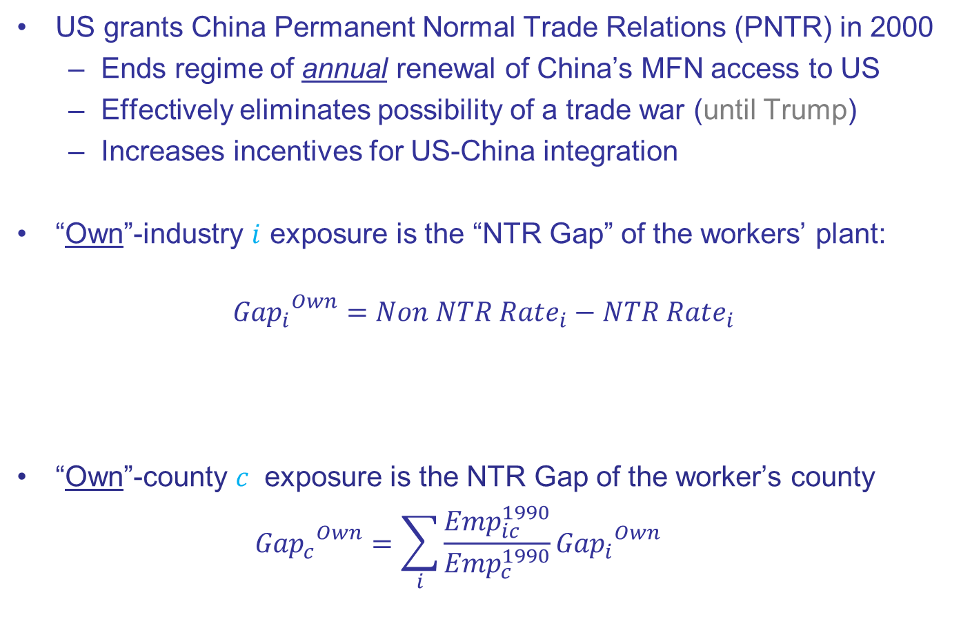
“Own” Exposure to PNTR
US grants China Permanent Normal Trade Relations (PNTR) in 2000
Ends regime of annual renewal of China’s MFN access to US
Effectively eliminates possibility of a trade war (until Trump)
Increases incentives for US-China integration
“Own”-industry $i$ exposure is the “NTR Gap” of the workers’ plant:
$${{Gap}_{i}}^{Own}=Non NTR Rate_{i}−NTR Rate_{i}$$
“Own”-county $c$ exposure is the NTR Gap of the worker’s county
$${{Gap}_{c}}^{Own}=\sum_{i}{\frac{Emp_{ic}^{1990}}{Emp_{c}^{1990}}{{Gap}_{i}}^{Own}}$$
High tariff rate If annual renewal fails
Low tariff rate under annual renewal
Notes:
Industry exposure captures industry switching costs
County exposure captures spatial moving costs

Slide 17
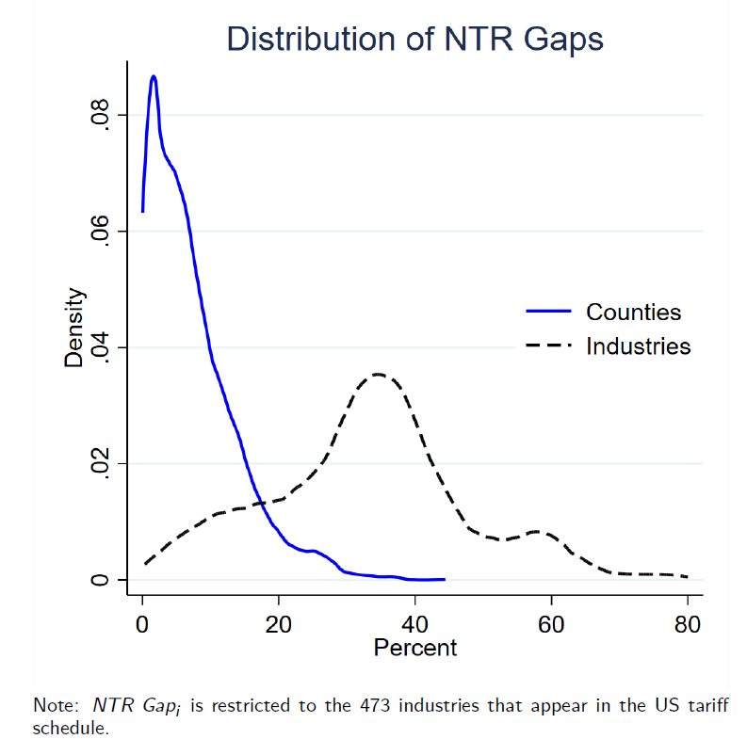
(All)
(M Only)
Notes:
75-25 interuartiles is around 20

Slide 18
NTR Gap Examples
Pierce and Schott (2016)

Slide 19
Industry NTR Gap Examples
Dolls, Toys, Games (0.70)
Wooden Windows (0.30)
Farm Machinery (0.08)
Pierce and Schott (2016)

Slide 20
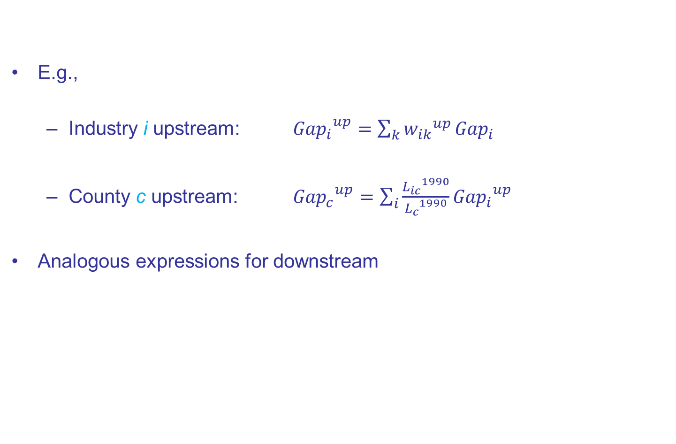
Supply-Chain Exposure
E.g.,
Industry i upstream: ${{Gap}_{i}}^{up}=\sum_{k}{{w_{ik}}^{up}}{Gap}_{i}$
County c upstream: ${{Gap}_{c}}^{up}=\sum_{i}{\frac{{L_{ic}}^{1990}}{{L_{c}}^{1990}}}{{Gap}_{i}}^{up}$
Analogous expressions for downstream
Total requirements IO-coefficient

Slide 21
Up- and Downstream Industry Exposure Manufacturing versus Non Manufacturing
median
Hospitals (622)
Textiles (313)
R&D (5417)
median

Slide 22
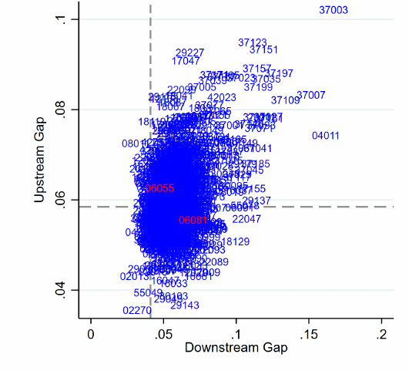
Up- and Downstream County Exposure Medians Noted with Dashed Lines
Napa (06055)
Santa Clara (06081)
“Silicon Valley”

Slide 23
Outline
Introduction
Data
MgNM Reallocation 2000-2007
Exposure to PNTR
Baseline DID Results
PNTR and worker attributes
Conclusion

Slide 24
Regression Samples
Only 19 states have data available before PNTR (1993-1999)
BUT these workers can be followed across 46 states after 1999
Draw 5% random stratified sample of “non-retiring” workers employed all years from 1993 to 1999, and follow them through 2014
Age<64 in 2014
Sample has >1M workers, >200K firms
20% of workers initially at M firms; 80% initially at NM firms
Follow labor literature, compare mixed- vs high-tenure workers
Mixed-tenure: employed entire pre-period
High-tenure: employed by same firm entire pre-period

Slide 25
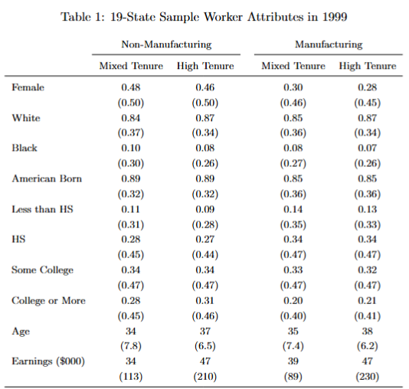
Mixed tenure less male and less white than high tenure
Mixed tenure less educated than high tenure
Mixed tenure lower earnings than high tenure

Slide 26
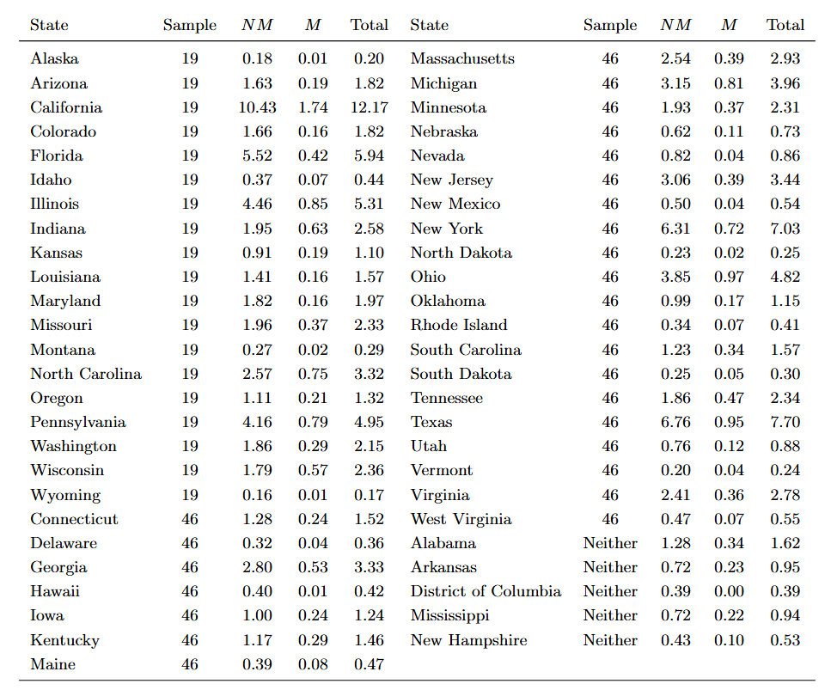
1999 Employment in the 19- vs 46-State Samples

Slide 27
1999 Employment in the 19- vs 46-State Samples
Mixed NM sample is 36% percent of this total (20*17.36/22)/44.2
Mixed M sample is 51% percent of this total (20*4.27/22)/7.6
High NM sample is 9% percent of this total (20*17.36/22)/44.2
High M sample is 18% percent of this total (20*4.27/22)/7.6
Implies constantly employed is more prevalent in manufacturing

Slide 28
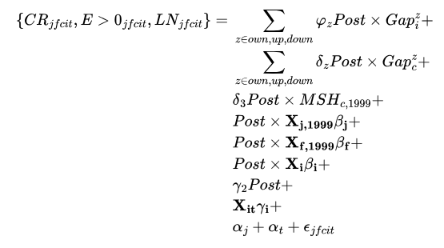
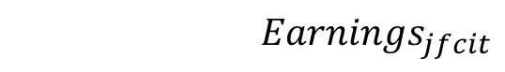
“Post” DID Specification worker j, firm f, county c, industry i, year t
$$Earnings_{jfcit}$$
Up to 6 DID terms of interest
One of 3 earnings transformations
Borusyak et al., (2021) incomplete shares
Worker, firm and industry characteristics
Time-varying industry characteristics

Slide 29
Earnings Transformations
Consider 3 transformations of earnings (Chen and Roth 2023)
“LN” log earnings
intensive margin of earnings conditional on employment
“E>0” dummy for earnings>0
extensive margin of employment
“CR” (Chen-Roth) replace 0’s with min observation and log
combines extensive and intensive margins

Slide 30
Earnings Transformations
Consider 3 transformations of earnings (Chen and Roth 2023)
“LN” log earnings
intensive margin of earnings conditional on employment
“E>0” dummy for earnings>0
extensive margin of employment
“CR” (Chen-Roth) replace 0’s with min observation and log
combines extensive and intensive margins

Slide 31
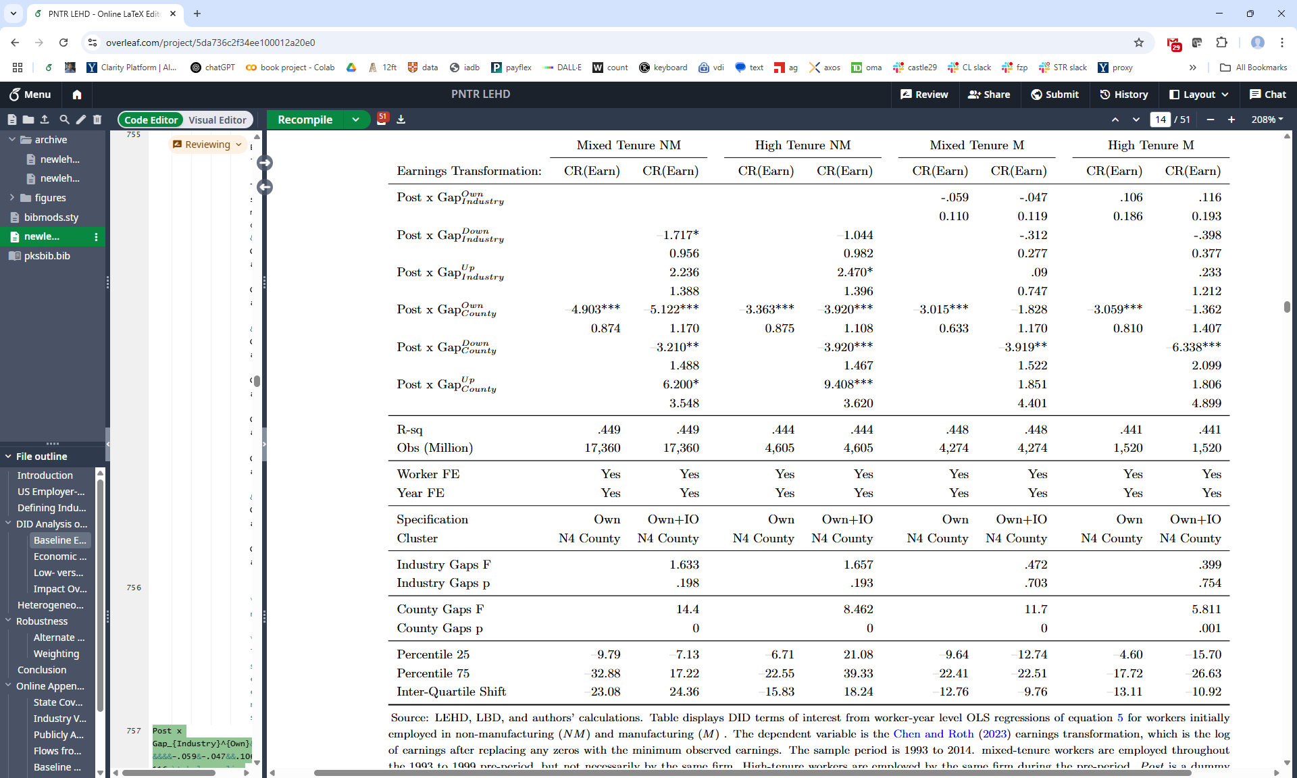

Slide 32
Chen-Roth all-in earnings transformation (like log w/0’s)
NM workers do not have own industry exposure
_
Industry exposure terms not jointly significant
_
_
_
County exposure terms highly significant
_
_
_
Accounting for IO exposure important; difference between relative loss and gain
_

Slide 33
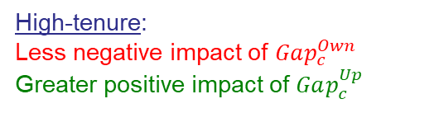
_
_
_
_
_
_
_
_
High-tenure:
Less negative impact of $Gap_{c}^{Own}$ Greater positive impact of $Gap_{c}^{Up}$
_
_
_
_
_
_
_

Slide 34
_
_
_
_
_
_
_
_
_
_
_
_
_
_
_
_
_
_
_
_
_
_
_
_
_
_
_
_
_
_
_
_

Slide 35
How to Visualize Economic Significance
Can’t look at usual inter-quartile shifts with 6 exposures
Instead, construct county-industry predicted relative earnings using DID coefficients x county and industry exposures
x Gaps = Predicted Growth

Slide 36
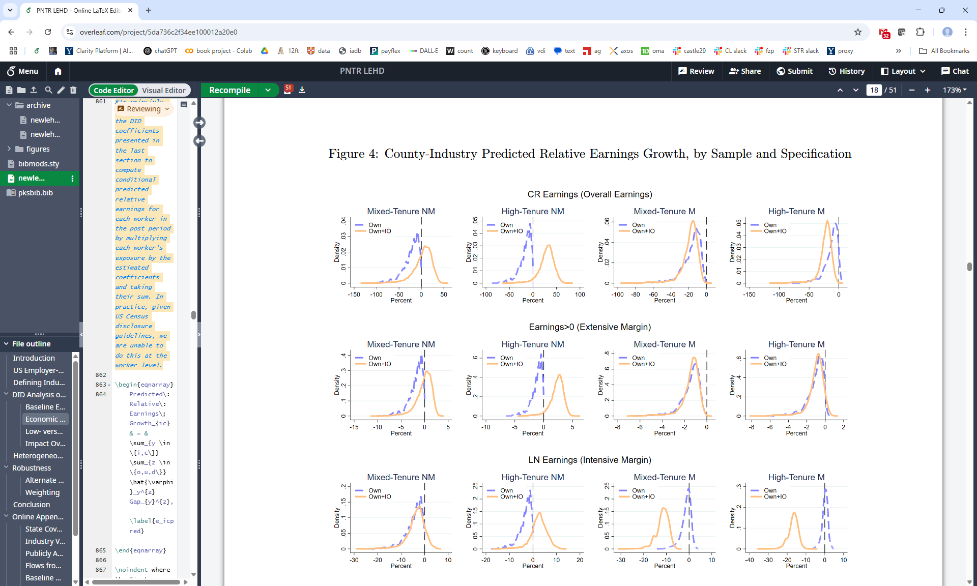
Visualizing Economic Significance Mixed-Tenure NM Workers
Predicted Relative Earnings Growth
Mixed Tenure NM
For NM workers, ignoring up- and downstream exposure in “Own Only” leads to under-estimation of relative income gains
Own Only
Own+IO
Each point is a different county-industry relative income growth prediction
Interquartile shift on previous slide

Slide 37
Visualizing Economic Significance NM Workers
Predicted Relative Earnings Growth
High-tenure NM workers achieve even greater predicted relative earnings gains from upstream exposure than mixed-tenure

Slide 38
Visualizing Economic Significance M Workers
Predicted Relative Earnings Growth
For M workers, ignoring up- and downstream exposure leads to underestimation of relative earnings losses
Similar patterns show up across the intensive and extensive margins

Slide 39
Results by Margin and Sample

Slide 40
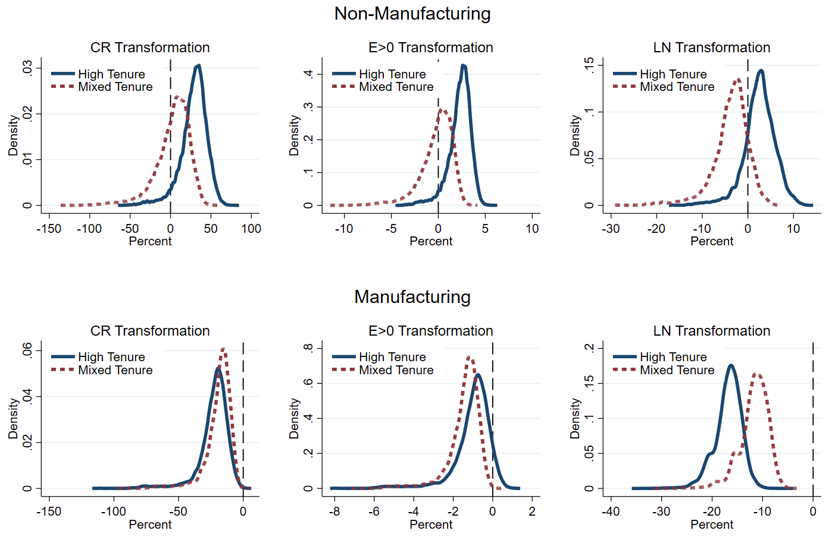
County-Industry Predicted Relative Earnings Growth Own+IO Post Specification, by Margin
High Tenure
High Tenure
High Tenure
Mixed
Tenure
Mixed
Tenure
Mixed
Tenure
High-Tenure M more likely to remain employed, but see larger earnings declines
Mixed
Tenure
High Tenure
Mixed
Tenure
Mixed
Tenure
High Tenure
High Tenure

Slide 41
“Annual” DID Specification

Slide 42
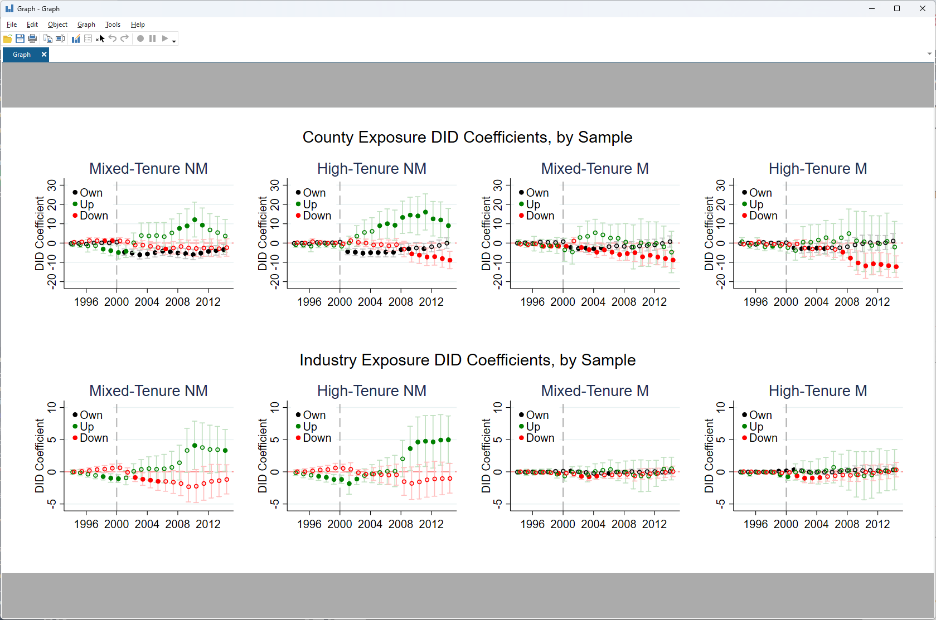
“Annual” DID Regression Coefficients
County Exposure Coefficients
Mixed Tenure NM
Insignificant
Significant 95%
County Upstream: grows and becomes significant starting in 2008
County Downstream: generally insignificant
County Own: coefficient is negative and significant on impact

Slide 43
“Annual” DID Regression Coefficients
County Exposure DID Terms
Supply chain exposure more substantial for High-Tenure Workers
Industry Exposure DID Terms

Slide 44
“Annual” DID Regression Coefficients
County Exposure DID Terms
Supply chain exposure more substantial for High-Tenure Workers
Industry Exposure DID Terms
Industry upstream exposure also contributes to High-Tenure NM worker predicted relative income gains

Slide 45
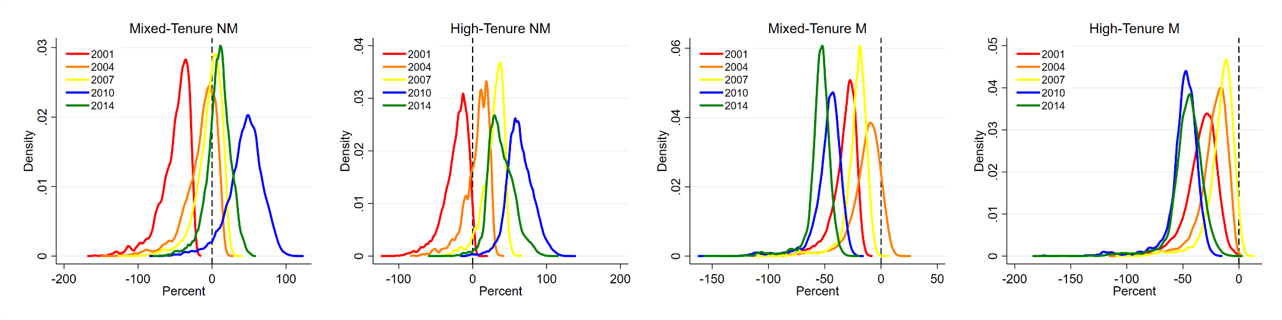
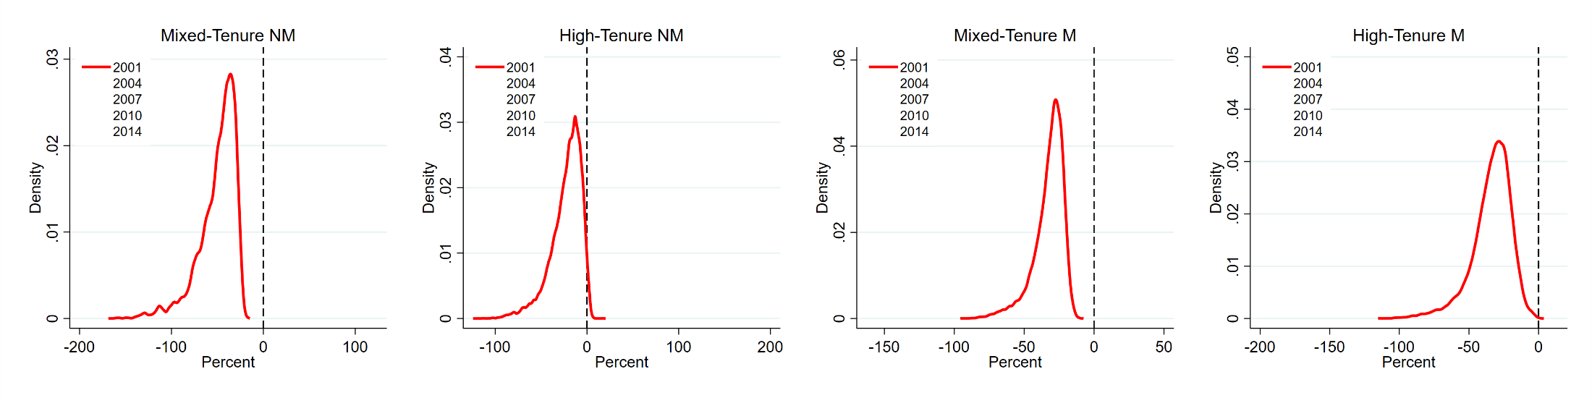
Use “Annual DID” to Predict Relative Growth by Year
Mixed Tenure NM
High Tenure NM
Mixed Tenure M
High Tenure M
Predicted Relative Earnings Growth in Year $t$

Slide 46
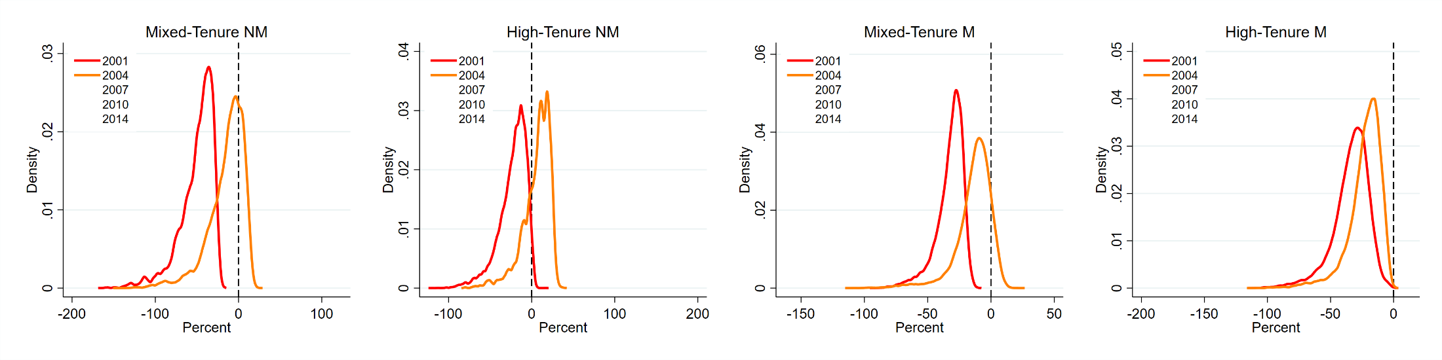
Use “Annual DID” to Predict Relative Growth by Year
Mixed Tenure NM
High Tenure NM
Mixed Tenure M
High Tenure M
Predicted Relative Earnings Growth in Year $t$

Slide 47
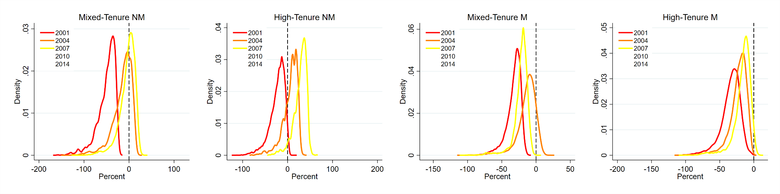
Use “Annual DID” to Predict Relative Growth by Year
Mixed Tenure NM
High Tenure NM
Mixed Tenure M
High Tenure M
Predicted Relative Earnings Growth in Year $t$

Slide 48
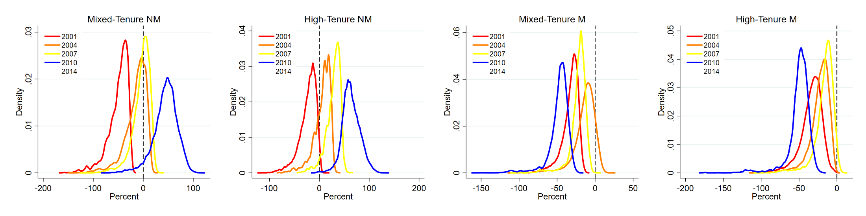
Use “Annual DID” to Predict Relative Growth by Year
Mixed Tenure NM
High Tenure NM
Mixed Tenure M
High Tenure M
Better
Better
Worse
Worse
Predicted Relative Earnings Growth in Year $t$
Stark difference between NM and M: Great Recession makes China Shock worse for M

Slide 49
Use “Annual DID” to Predict Relative Growth by Year
Mixed Tenure NM
High Tenure NM
Mixed Tenure M
High Tenure M
Predicted Relative Earnings Growth in Year $t$

Slide 50
Intuition for Own+IO Results?
Several links of an M supply chain with various levels of exposure may move offshore together if productivity depends on proximity (Baldwin and Venables 2013).
In that case upstream exposure may offer no benefit to M, and downstream exposure is particularly disruptive to M.
But outside manufacturing, such co-migration may not be possible, e.g., hospitals must stay within reach of their patients, and hotels must remain close to their guests.

Slide 51
Outline
Introduction
Data
MgNM Reallocation 2000-2007
Exposure to PNTR
Baseline DID Results
PNTR and worker attributes
Conclusion

Slide 52
Triple Interaction DID
Interact IO exposures with initial worker attributes
Worker demographics
Female vs male
Below age 30 or above
At least bachelors degree or not
Non-white vs white
Top earnings quartile in pre-period
Workers’ firms’ attributes
Worker at small vs large firm
Worker at trading vs non-trading firm
Worker at diversified vs non-diversified firm

Slide 53
Triple Interaction DID
Interact IO exposures with initial worker attributes
Worker demographics
Female vs male
Below age 30 or above
At least bachelors degree or not
Non-white vs white
Top earnings quartile in pre-period
Workers’ firms’ attributes
Worker at small vs large firm
Worker at trading vs non-trading firm
Worker at diversified vs non-diversified firm
NM: Females vs males have higher predicted relative earnings gains
NM and M: Initial high earners have higher predicted relative earnings (both intensive and extensive) (for M, consistent ADHS 2014)
M: Workers at initially small firms have higher predicted relative earnings than workers at initially large firms

Slide 54
Conclusions
Non-manufacturing workers exhibit relative earnings gains
High-firm-tenure worker fare relatively better than low-tenure workers
Ignoring up- and downstream exposure leads to …
Underestimation of NM workers’ relative income gains
Underestimation of M workers’ relative earnings losses
Spatial exposure matters more than industry exposure
Great Recession exacerbates the China Shock

Slide 55
Thanks!

